Slide 1
The ITB Policy and Research and Development

Slide 2
R&D
R&D is included as a key tenet of Value Proposition (VP) due to its known ability as an economic growth driver.
Points could be awarded to a VP proposal according to the number of commitments in this area whether directly related to the procurement, the defence sector, or other sectors of the economy
R&D undertaken in Canada
R&D in Canadian post-secondary institutions
R&D

Slide 3
Public Private Consortia
The ITB Policy provides multipliers for the creation and ongoing support of public/private research consortia. Should a company invest in a Public/Private Consortia, they could receive credit for up to 5X their investment.
A Public/Private Consortia consists of three elements:
A Prime Contractor with an ITB obligation.
A Canadian based company with no ITB obligation.
A publicly funded Canadian research institute.

Slide 4
Example of Public/Private Consortia
Consortium in Quantum Computing
Prime Contractor: Lockheed Martin Aeronautics Company
Recipient companies: D-Wave Systems, several Canadian universities
Fulfilling LM’s obligations on the C130J program
Description: LM developed the consortia to research quantum computing and purchased D-wave’s first ever quantum computing system.

Slide 5
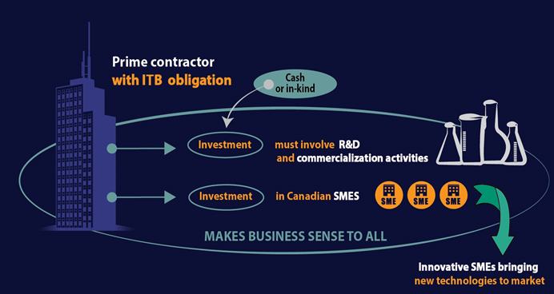
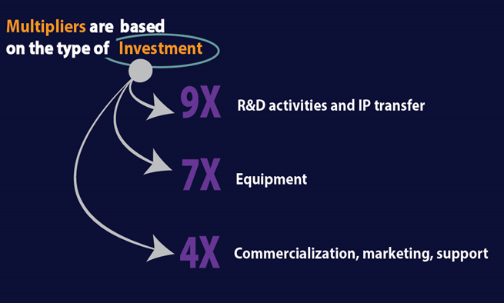
Investment Framework
Investment Framework Transactions (IF): The Investment Framework incentivizes prime contractors to invest in research and development as well as commercialization undertakings by SMEs in Canada by crediting their investments in SMEs at multiples of their face value.

Slide 6
Example of Investment Framework
Solace Power Inc. of Mount Pearl, Newfoundland and Labrador, received financial and technical support from Boeing to develop and demonstrate its wireless charging technology.
Solace has developed the capability to recharge unmanned aerial vehicles (UAV) in flight through wireless electrical energy. This will enable UAVs to travel further from station and stay in the air for longer periods of time.
Boeing made this investment as part of its Industrial and Technological Benefits Policy obligations resulting from the Government's December 2014 purchase of a C-17 Globemaster III aircraft.

Slide 7
AIF
The Atlantic Innovation Fund encourages partnerships among private sector firms, universities, colleges and other research institutions to develop and commercialize new or improved products and services.
Provides up to $3 million in assistance
75% of eligible costs
New, simplified, continuous application process
ACOA will assess;
Technical soundness
Commercialization
Economic benefit for Atlantic Canada

Slide 8
Build in Canada Innovation Program
Background
The Build in Canada Innovation Program was made permanent in 2012.
As of 2016, annual funding will be $40 million.
What the program does
Through a competitive procurement process, the government buys innovative pre-commercial goods and services, and tests them in government departments and other partners.
The Result
A win-win for both Canadian businesses and testing partners.
Businesses are better able to take the next step and sell their innovation on the marketplace.
Partners test, assess and keep innovations that are not yet available in the market.

Slide 9
Eligibility
All Proposals must meet the following Mandatory Criteria and pass the Screening Criteria of “Readiness” and “Commercialization Capacity”.
Be included in one of the Standard Priority Areas
Be included in one of the 6 Military Priority Areas
STANDARD
M
I
L
I
T
A
R
Y
Be valued at $500K or less
Be valued at $1 million or less
Not have been sold commercially
Be provided by Canadian bidders
Include 80% Canadian content
Show IP ownership or rights
Obtain minimum pass marks for “Advance on State of the Art”
Notes:
There are some basic elements that proposals will need to meet in order to be eligible for the BCIP. These include the mandatory, screening, and point-rated criteria.
Some of the mandatory criteria against which you will be evaluated are:
The proposal must be valued at $500K or less for the standard component and $1 million or less for the military component. We realize that there are lots of innovations out there that are of higher value, but right now, we are limited by the amount of funding that we have, and we want to be able to buy and test as many innovations as possible.
The innovation must fall under one of the priority areas; either under the standard or military component and considering how broad they are, this is an easy criterion to meet.
The proposed innovation must not have been sold commercially. This means that the innovation cannot have been sold commercially either here in Canada or abroad. The purpose of the program is to assist suppliers in moving their innovations from the lab to the marketplace – if you are not pre-commercial, than you fall outside the mandate of the program.
Bidders must be Canadian.
Include 80% Canadian Content. We are not measuring the percent of bits and pieces that are actually manufactured in Canada, though that may play into it. We are more concerned about where the development occurred and where the IP for the innovation resides.
We also have a requirement that the innovation score a minimum number of points in the evaluation of “advance on state of the art”, to make sure the goods and services we buy are innovative.
IMPORTANT TO KNOW: Commercial sales after the solicitation closing date are acceptable.
For full definitions of each of these mandatory criteria visit www.buyandsell.gc.ca.

Slide 10
How the program works
Call for Proposals Process
Start
BCIP uses a continuous intake process where suppliers can submit to the program at anytime
Proposal Submission
Testing is carried out with a test partner and feedback is provided
Proposals are submitted on an online submission service
Good/ Service Testing
NRC-IRAP Evaluates Proposals
Matched proposals proceed to negotiations
Proposal Debriefs
Contracting
Military Innovations sent to the Defence Validation Committee to facilitate matching with DND
Pre-qualified proposals
Matching to Test Partners

Slide 11
BCIP Contact Information
Program Site
For more information visit:
www.buyandsell.gc.ca/innovation
Update List
Subscribe to the BCIP update mailing list
(on home page of program website)
Tenders Site
The proposal form, amendments, and the online submission process are found here:
www.buyandsell.gc.ca/innovation
Program E-mail
Send inquiries to:
Innovation@pwgsc.gc.ca

Slide 12
National Research Council

